Slide 1

The Battle of Neighborhoods
-The New York City perspective –
Francesco Morena for Coursera Capstone Project

Slide 2

Predicting optimum location is valuable for new Restaurant business
New York City is the financial capital of USA. It is multicultural, provides lot of business opportunities, it is business friendly environment and attracted many different players into the market.
Business Problem:
Choise of first neighborhood to start restaurant business
Choise of neighborhood that has good amount of customers
Easy to replicate
Low competition
Succes Criteria:
Best neighborhood which meets aforementioned criteria.
Questions that can be asked:
What is best location in Brooklyn that has potential Italian Restaurant market?
Which areas are saturated with Italian restaurants, which untapped?

Slide 3
Data acquisition
To solve the aim of the project, we will need the following data:
List of Neighboroods in NYC, USA:
Data source : https://cocl.us/new_york_dataset
Description : This data set contains the required information. And we will use this data set to explore various neighborhoods of new york city.
Venue data, particularly related to Italian Restaurant:
Data source : Fousquare API
Description : By using this api we will get all the venues in each neighborhood. We can filter these venues to get only italian restaurants.

Slide 4
Methodology
In general, this project would be encompassing a series of Data Science techniques, including, but not limited to, Data Cleaning, Data Wrangling and Machine Learning (K-Means clustering algorithm)
Approach:
Collect the New York City data from https://cocl.us/new_york_dataset
Using FourSquare API we will find all venues for each neighborhood
Filter out all neighborhoods of Brooklyn
Filter out all venues that are Italian Restaurants, Office, University, Hischool
Analyze venues of interest using FouSquare API
Using rating for each neighborhoods , we will sort that data
Visualize the Ranking of neighborhoods using folium library(python)
K-Means clustering and Clustering Analisys

Slide 5
Methodology
For each neighborhood, the sums of the office, school, university and italian restaurant were computed and for each of this 4 categories, a weight (or penalty) has been defined according to what stockholder considers the most important.
Italian restaurant have been weighted with -1, since stockholder wants to avoid concurrence
HighSchools have been weighted with 1, since employees/student are good customers
Universities have been weighted with 1.5, since employees/students are good customers
Offices have been weighted with 2, since employees are even better customers
A score was computed for each locality as the weighted sum of the number of venues in each of the 4 categories (school, university, office, Italian Restaurant)
Lastly, K-Means clustering is performed on this data set to return clusters, or categories of neighborhoods in terms of number of Italian Restaurant
Questions that can be asked using the aforementioned datasets:
What is best location in Brooklyn that has potential Italian Restaurant market?
Which areas are saturated with Italian restaurants, which untapped?

Slide 6
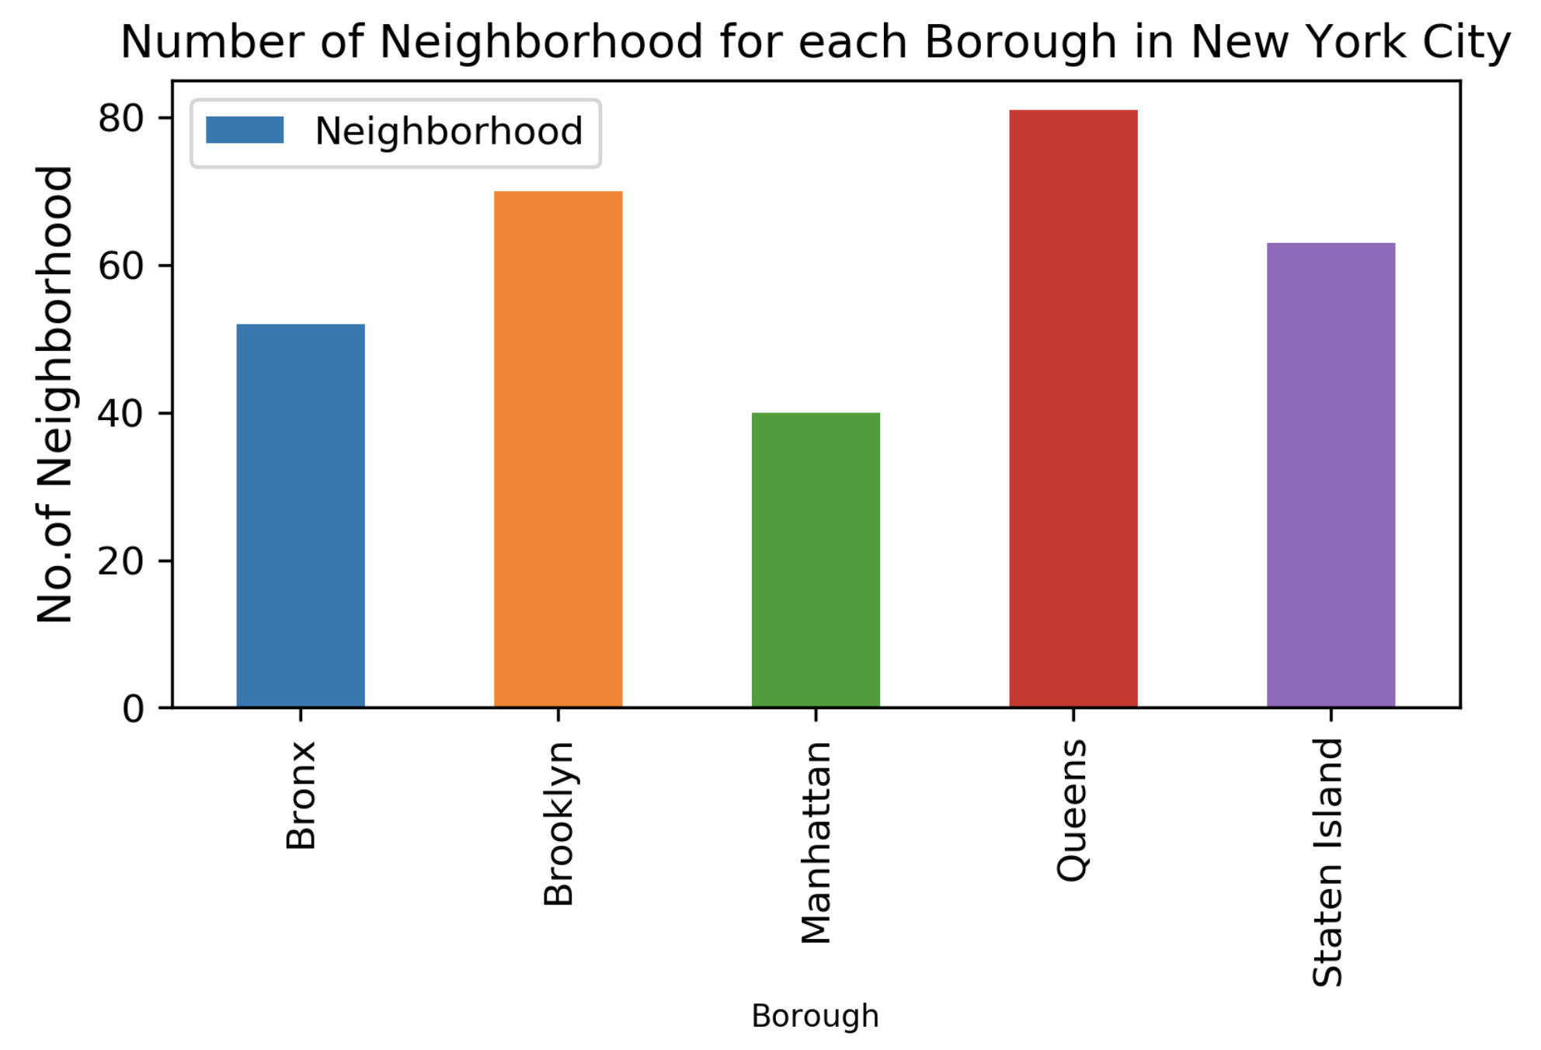
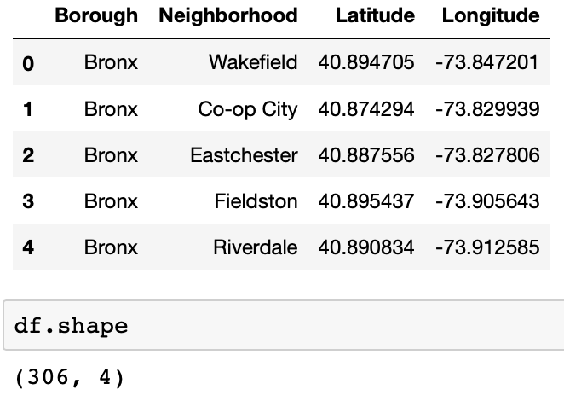
There are 5 Borough and 306 Neighborhood across New York City
Queens has the highest number of neighborhoods, followed by Brooklyn and Staten Island

Slide 7
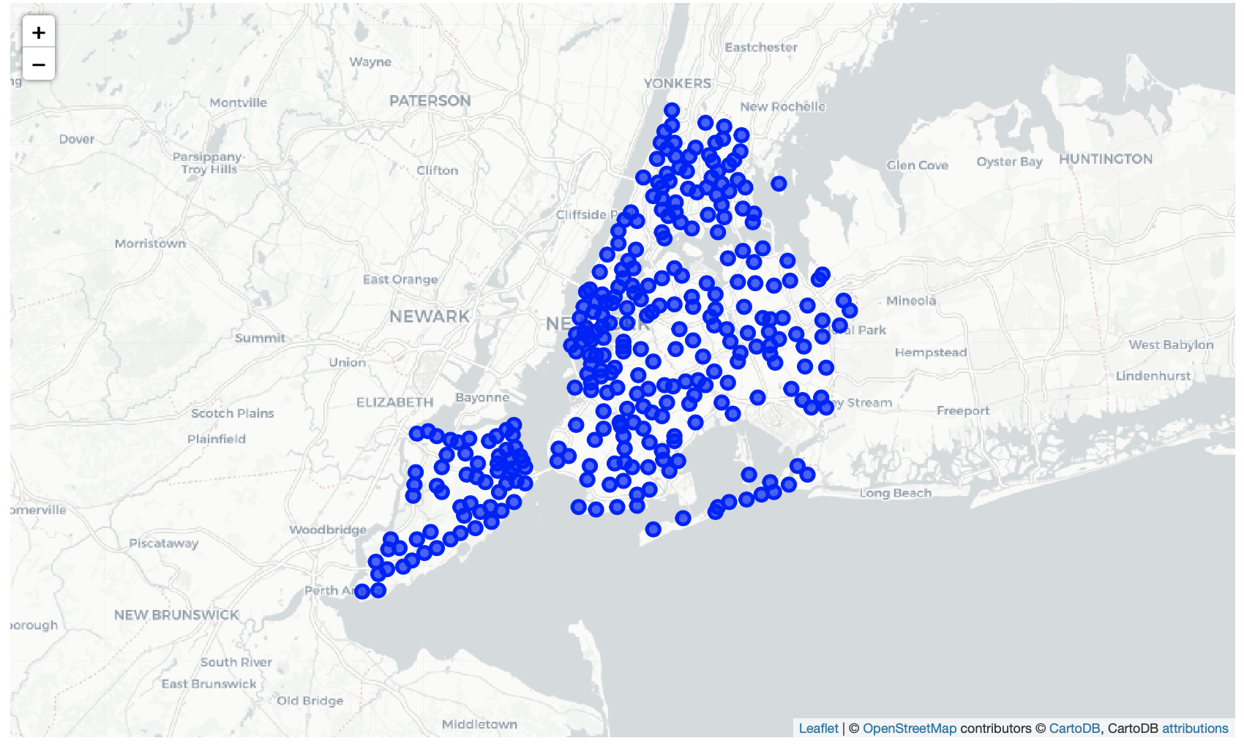
Map of 306 Neighborhood across New York City

Slide 8
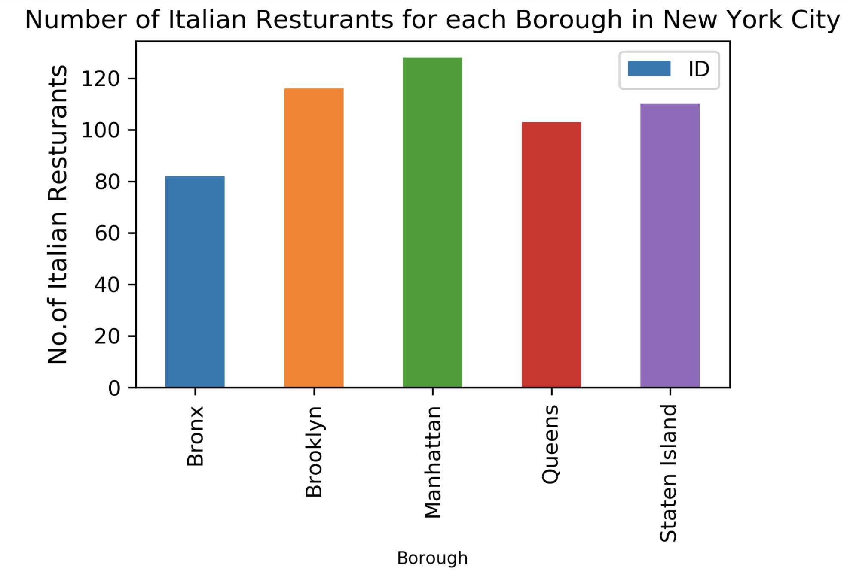
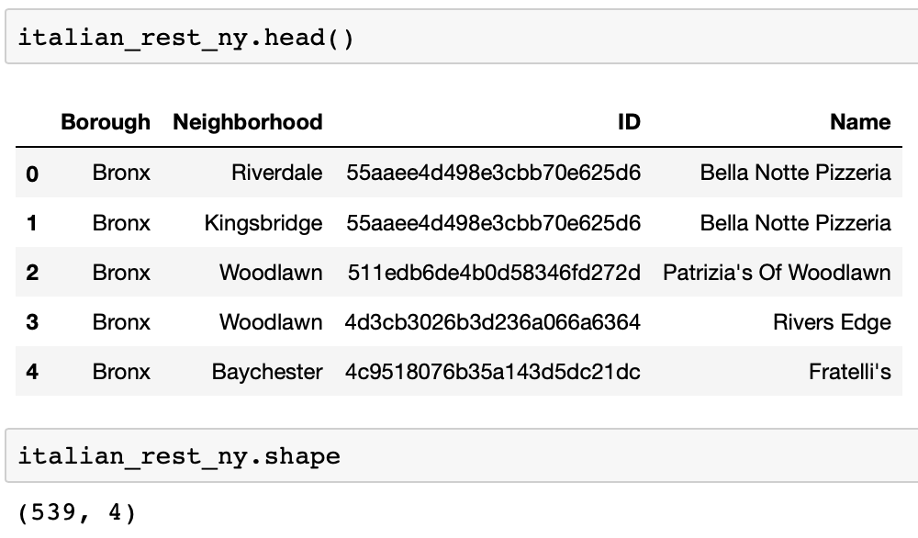
The are 539 Italian Resturants across Borough in New York City
Manhattan has the largest number of italian resturants, followed by Brooklyn. Bronx has the smallest number of italian resturants.

Slide 9
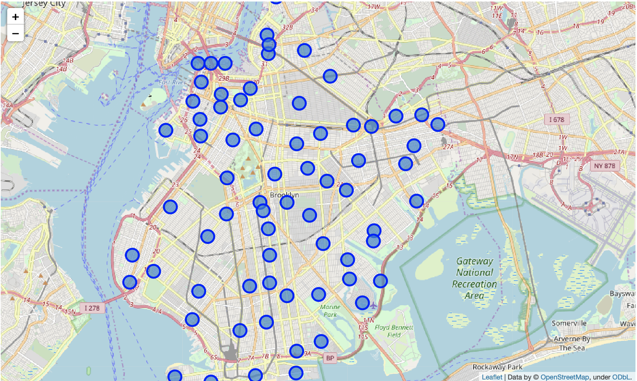
Map of 70 Neighborhoods in Brooklyn
Due to the aim of the project and the request of the stockholder, we taking into account Italian Restaurants in a specific area: Brooklyn

Slide 10
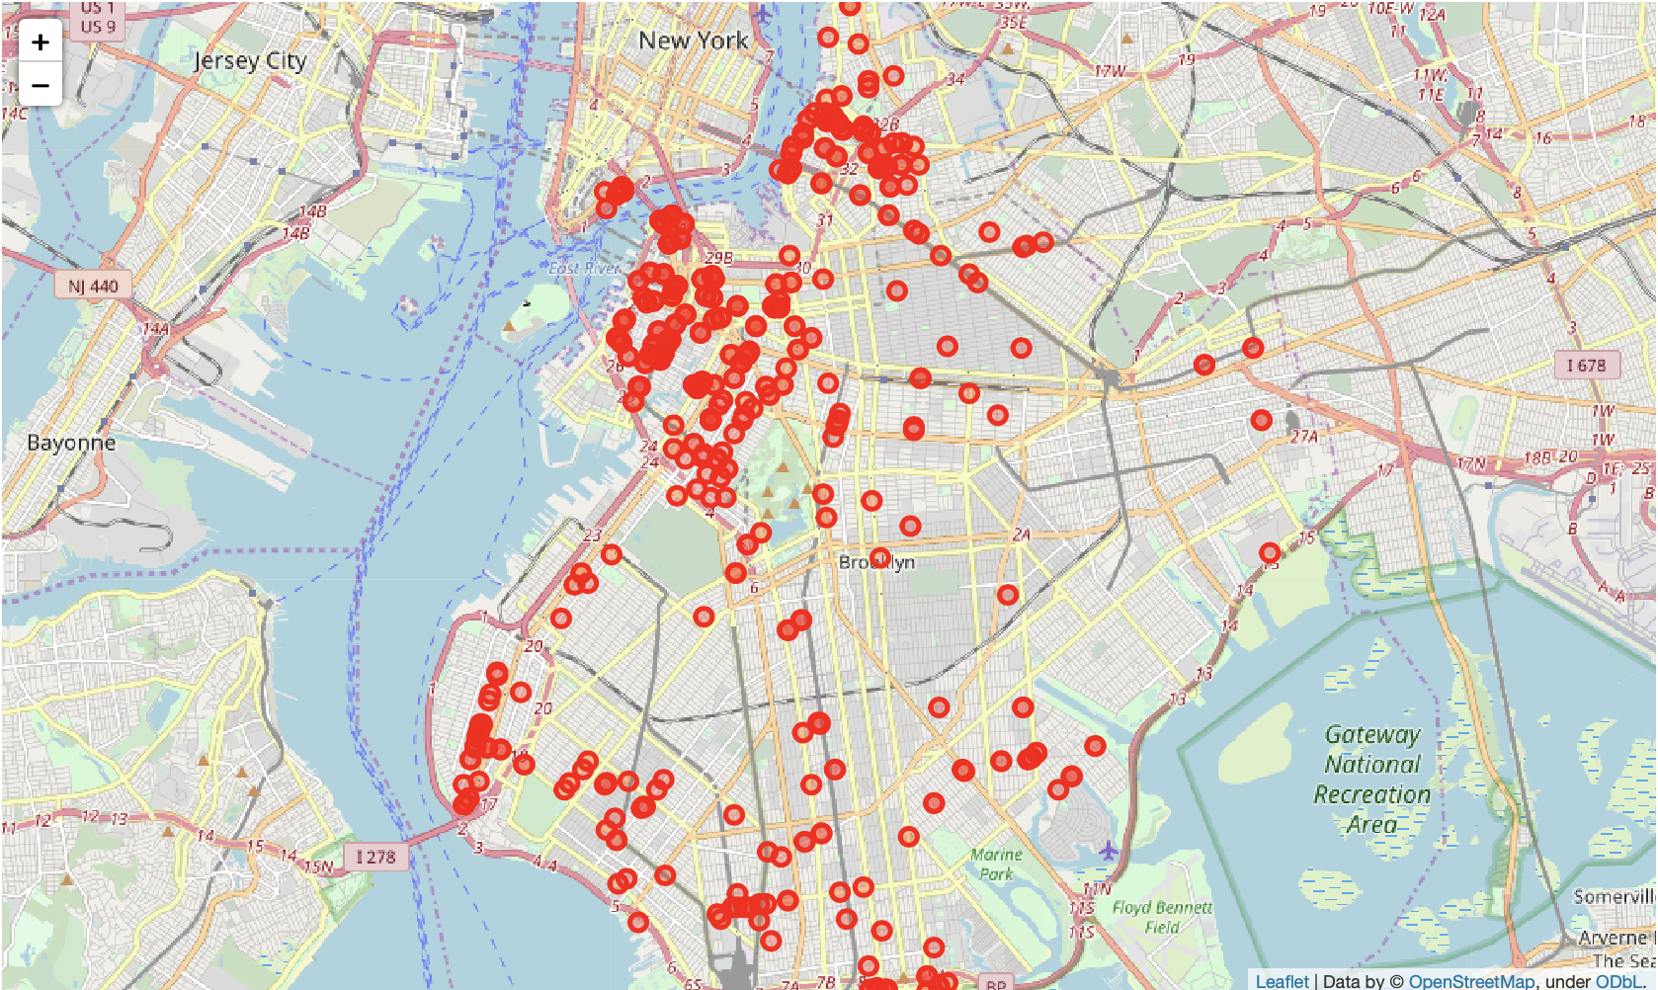
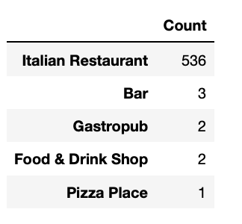
Map of Italian Restaurants in Brooklyn
The are 536 Italian Restaurants across Brooklyn

Slide 11
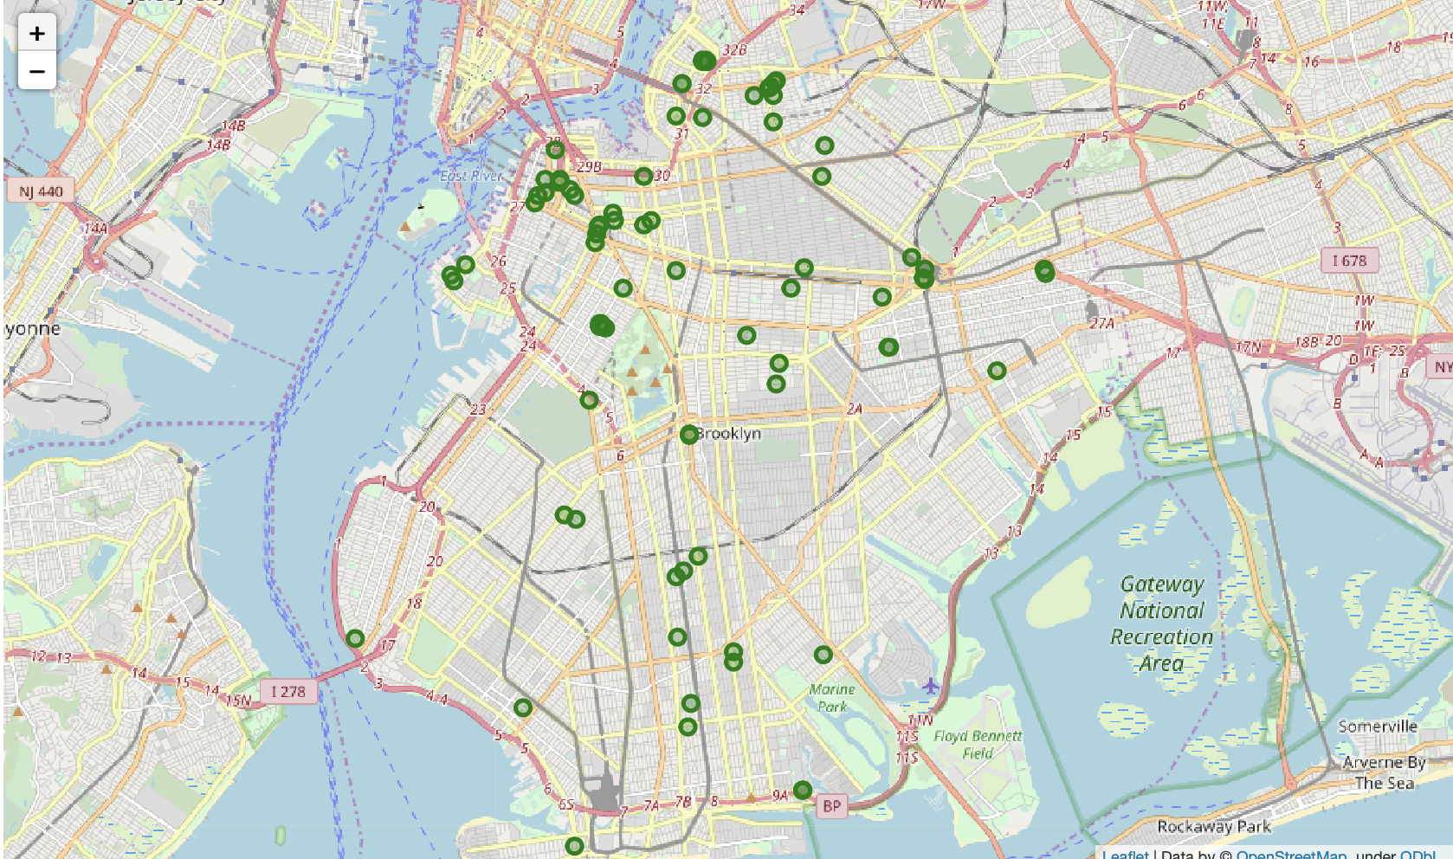
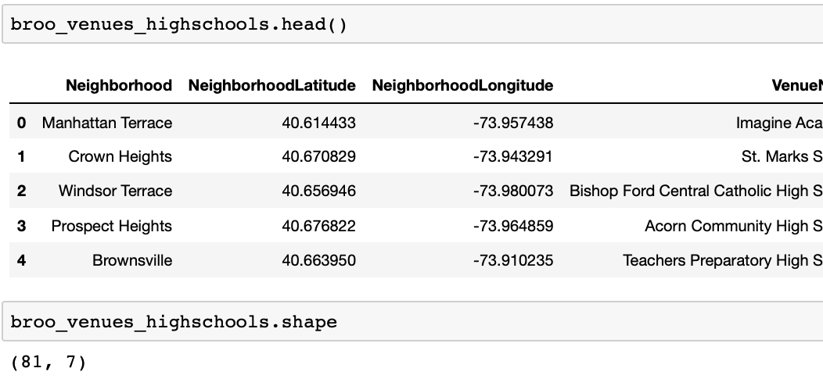
Map of HighSchools in Brooklyn
The are 81 HighSchools across Brooklyn

Slide 12
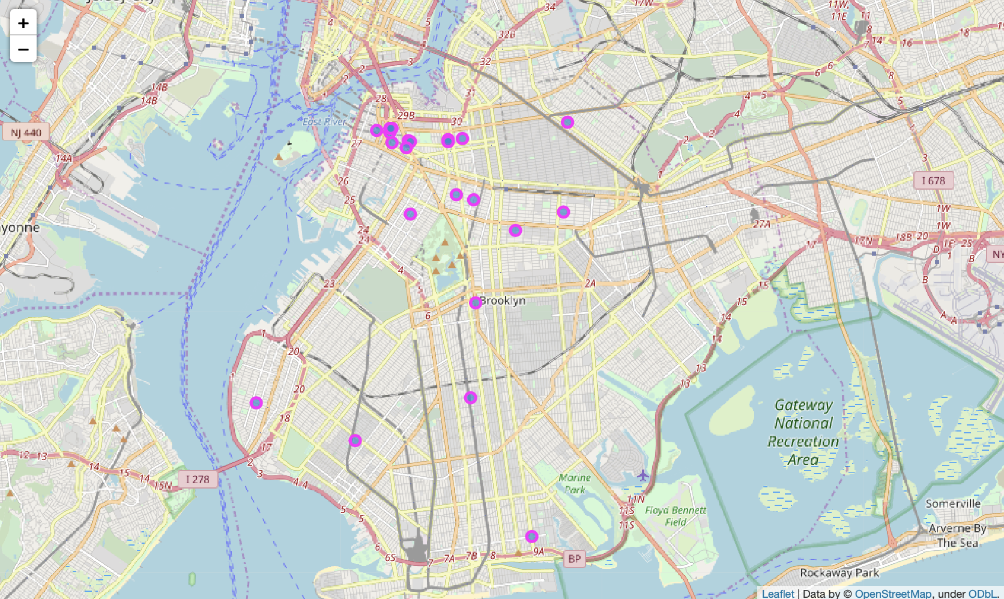
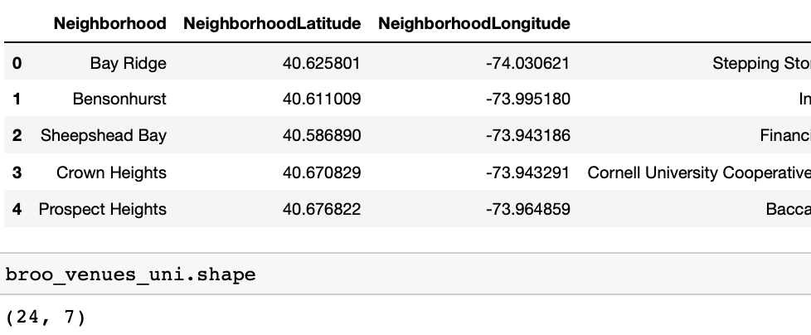
Map of Universities in Brooklyn
The are 24 Universities across Brooklyn

Slide 13
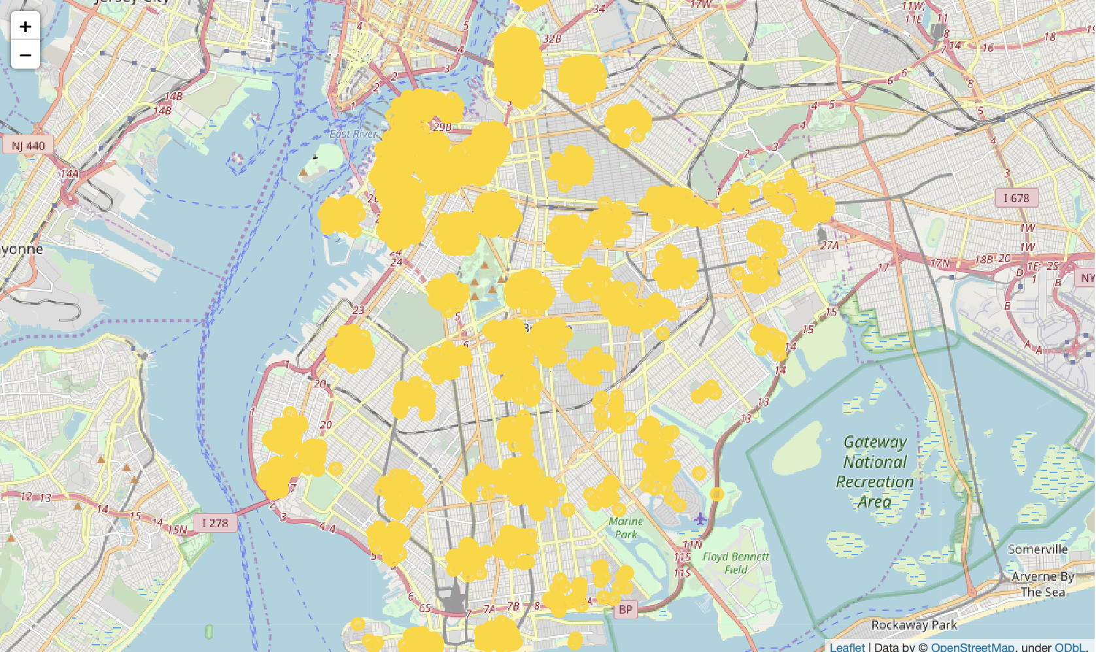
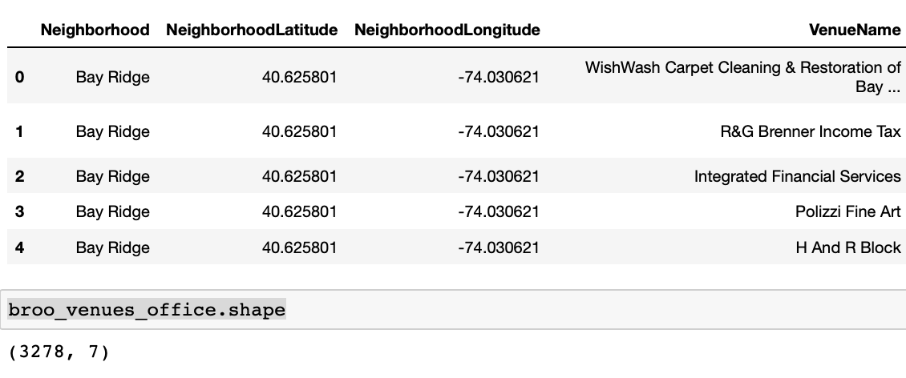
Map of Offices in Brooklyn
The are 3278 Offices across Brooklyn

Slide 14
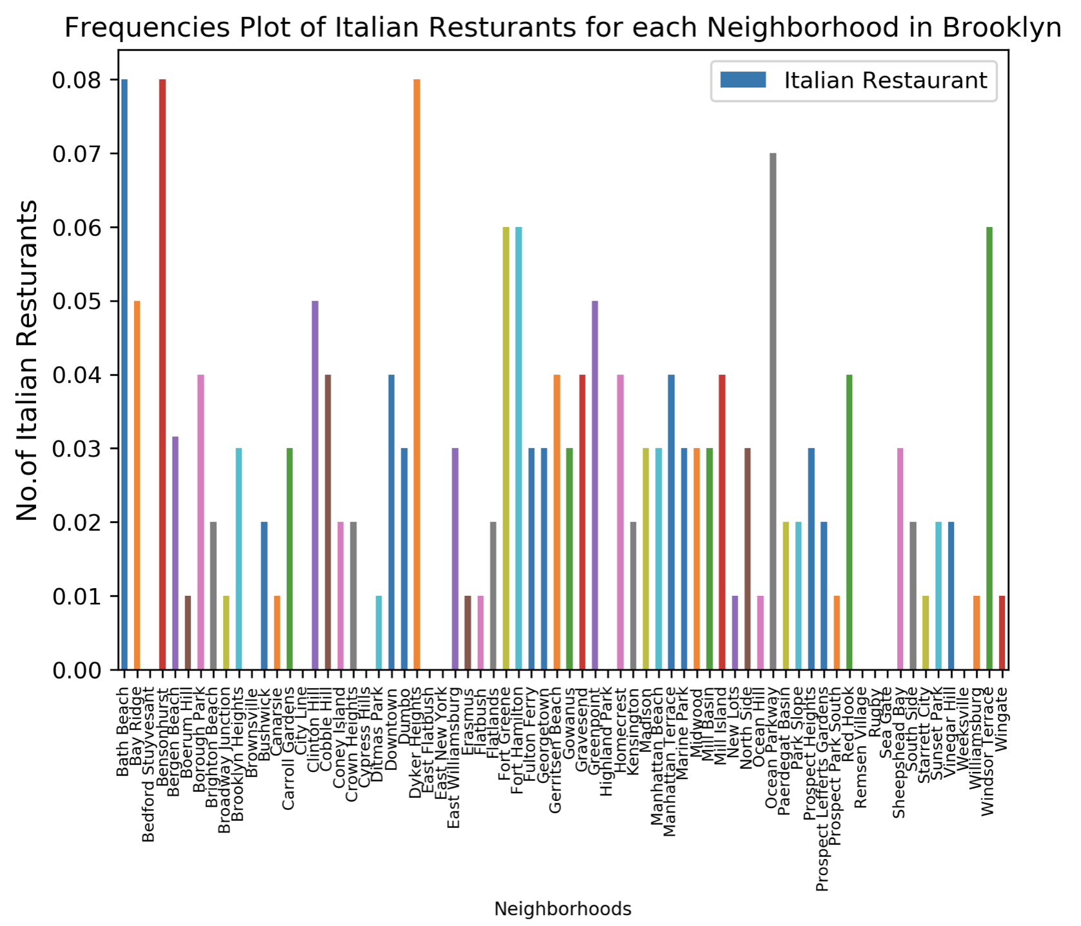
Frequencies Plot

Slide 15
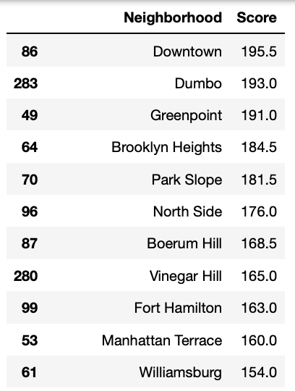
Results
The neighborhoods with the best score are:
Downtown, Dumbo, Greenpoint, Brooklyn Heights and Park Slope are some of the best neighborhoods for stockholder in order to open his Italian Restaurant.
These options maximize the number of potential customers from Offices and Universities and at the same time have not too large competitor.
However, analyzing the Neighborhood with the best score, Dumbo would seem to be the most suitable as the one with the lowest number of Italian restaurants (7), compared to the Downtown (17), Greenpoint (9), Broklyn Heights (22) and Park Slope (26).
Dumbo with a score of 193.0 being
the best option

Slide 16
Frequencies Plot with Dumbo highlighted

Slide 17
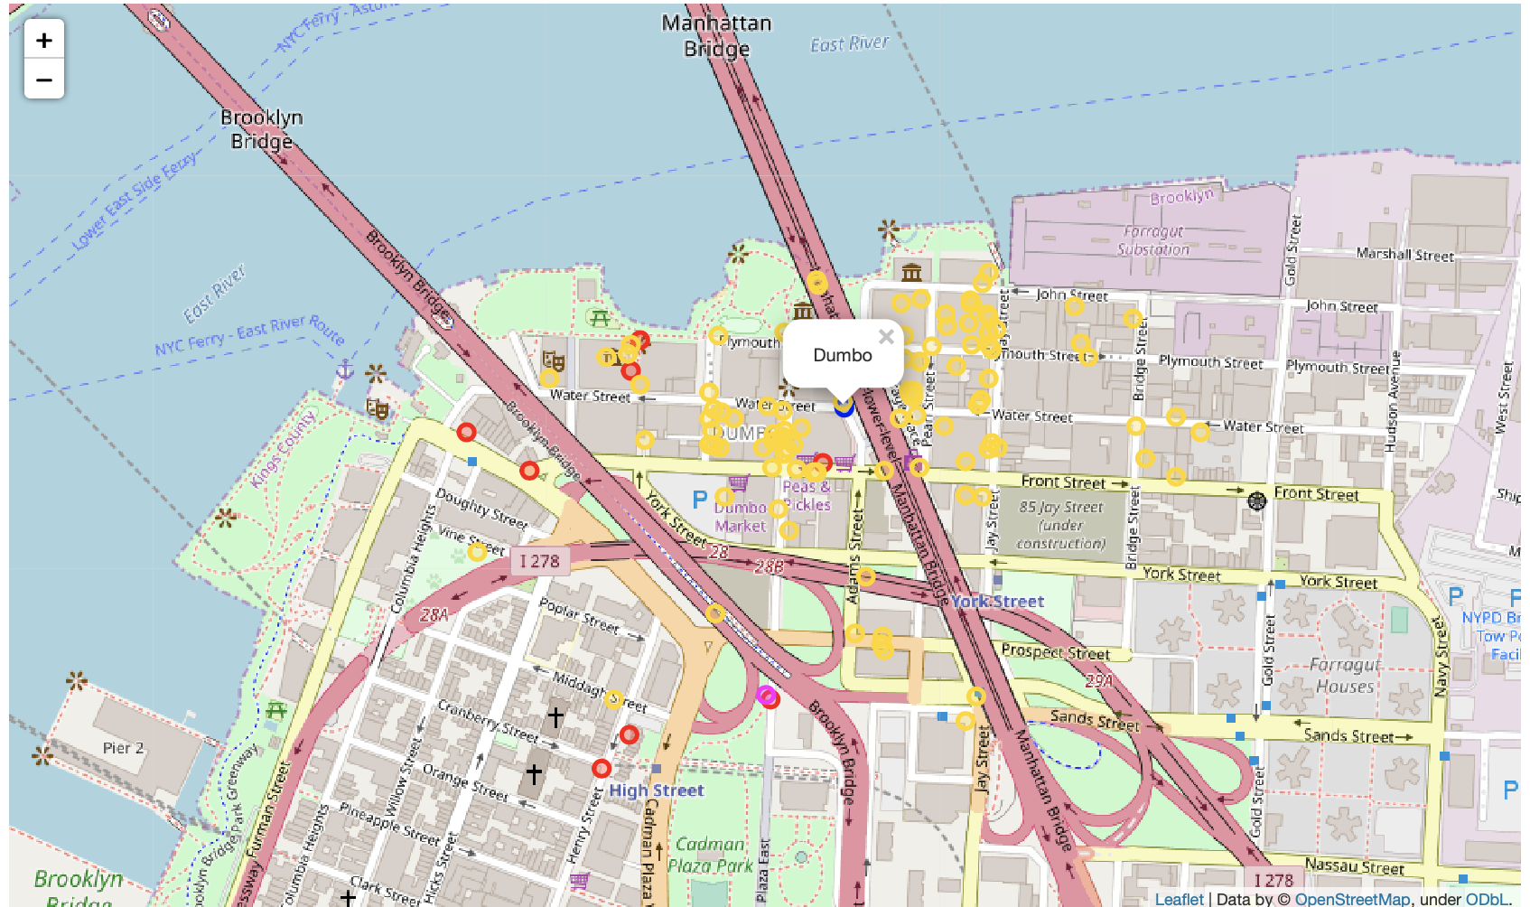
Best Place for the Italian Restaurant in Brooklyn is ‘DUMBO’
Gold = Offices
Red = Italian Rest

Slide 18
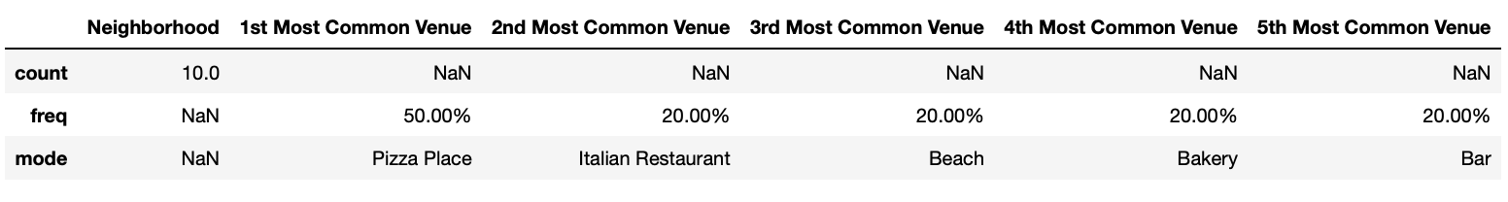
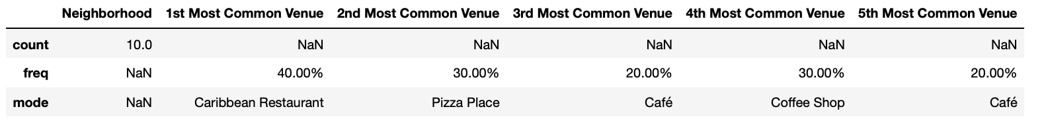
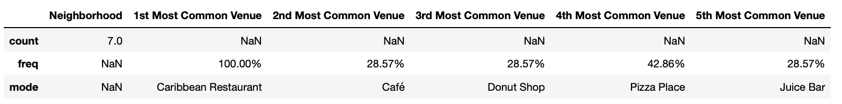
K-Means Clustering
Top 5 most common venues in cluster 0
Top 5 most common venues in cluster 1
Top 5 most common venues in cluster 2

Slide 19
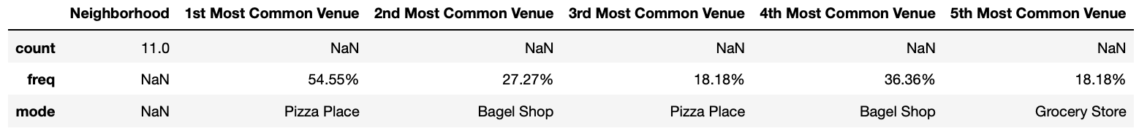
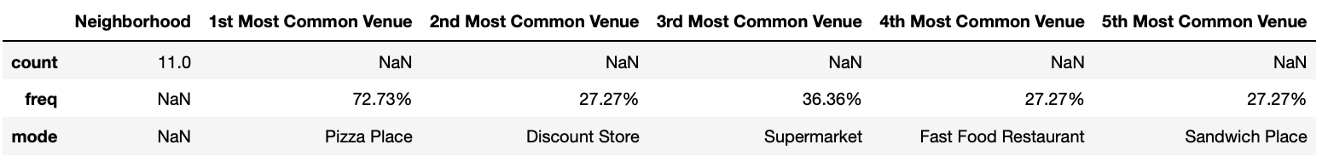
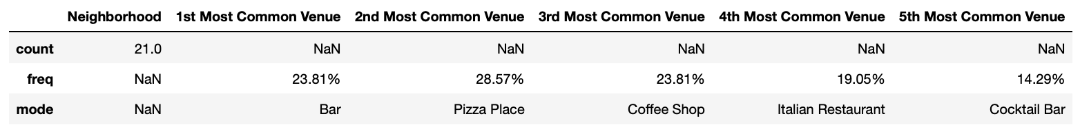
K-Means Clustering
Top 5 most common venues in cluster 3
Top 5 most common venues in cluster 4
Top 5 most common venues in cluster 5

Slide 20
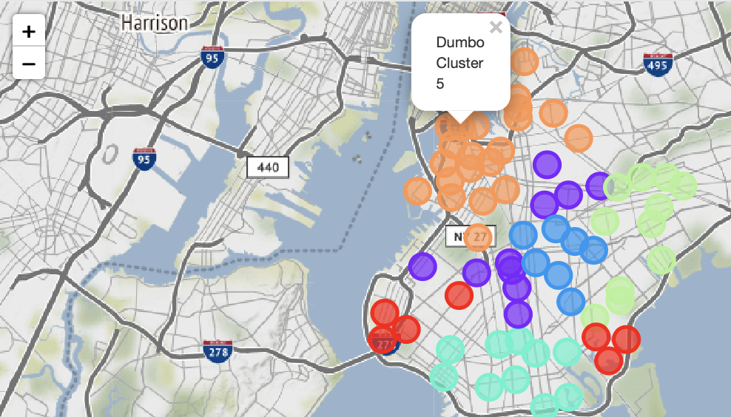
K-Means Clustering results
The following are the highlights of the 6 clusters:
Pizza Place and Italian Restaurant are the most popular in the cluster 0. The Italian Restaurants are very popular in this cluster, especially in Dyker Heights, Fort Hamilton and Bay Ridge areas.
In clusters 1 and 2 predominant is the Caribbean Restaurant, which suggests a prevalent Caribbean presence, followed by Cafe and Pizza Place;
Pizza Place, Bagel shop, and Grocery Store are the most popular in the cluster 3.
Pizza Place, Discount Store, Supermarket, and Fast Food Restaurant are the most popular in the cluster 4.
Bar, Pizza Place, Coffee Shops are the most popular in the cluster 5.
The best choice to open an Italian Restaurant could be cluster 5.
In this cluster reside our choice Dumbo

Slide 21
Conclusion and future directions
Cluster 5 is the most viable clusters to create a brand Italian Restaurant. Their proximity to other amenities are paramount. In this cluster, even if there are other Italian restaurants, the market is not saturated. So the rivalry could be minimal.
In conclusion, this project would have had better results if there were more data in terms of crime data within the area, parking access, bus and metro stop, and allowance of more venues exploration with the Foursquare (limited venues for free calls).
Also, getting the ratings and feedbacks of the current restaurants within the clusters would have helped in providing more insight into the best location.

